Slide 1
AP US History Exam - Review
Ch. 10
The Industrial Revolution
(1865-1898)
(Period 6: Forging an Industrial Society)

Slide 2
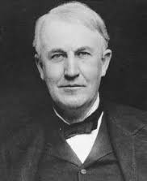
The Age of Invention and Economic Growth
Thomas Edison’s invention of the light bulb and the power station were critical to American industrial development:
-allowed for the extension of the workday.
-created greater opportunities for mass production.

Slide 3
Industrialization, Corporate Consolidation, and the Gospel of Wealth
Positives:
-corporation consolidation (trusts, monopolies, holding companies, etc.) allowed businesses and profits to grow quickly
-many jobs created quickly
Negatives
-work was monotonous, dangerous for workers
-consumers were taken advantage of through lack of competition
-rapid growth was erratic; led to recessions, depressions:
-Panics of 1873, 1893

Slide 4
Industrialization, Corporate Consolidation, and the Gospel of Wealth
Terms to Know:
-horizontal and vertical integration
-Sherman Anti-trust Act (1890)
-laissez faire
-Social Darwinism
(promoted by Carnegie, Rockefeller, etc.)
-Carnegie’s Gospel of Wealth

Slide 5
Factories and City Life
Industrialization drew people to the factories of the big cities, and this demographic shift caused cities (and the problems of cities) to grow dramatically . . .
--tenements were low-cost housing in which disease, crime, poverty, etc. were major problems
--manufacturers cut costs by hiring women, children, and immigrants, who could be paid lower wages.
--due to prejudice and necessity, immigrants settled in ethnic (islands) neighborhoods.
--political bosses, who ran ‘political machines’, took advantage of the desperation of immigrants to control them as a voting block.
--competition for jobs and resources often led to friction between ethnic and racial groups.

Slide 6
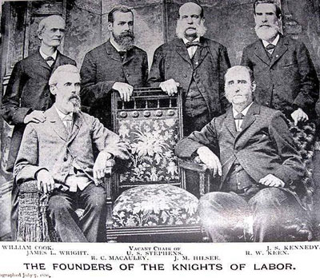
The Labor Union Movement
Widespread misery in the cities spurred a union movement:
-often considered radicals, unions were opposed by management and government.
Knights of Labor was the largest early labor union (1869).
-fought for eight hour work day, child labor laws, safety codes, government ownership of railroads, etc.
-Terence Powderly-Haymarket Square
American Federation of Labor (AFL)
-confederation of trade unions
-Samuel Gompers-’bread & butter’ unionism

Slide 7
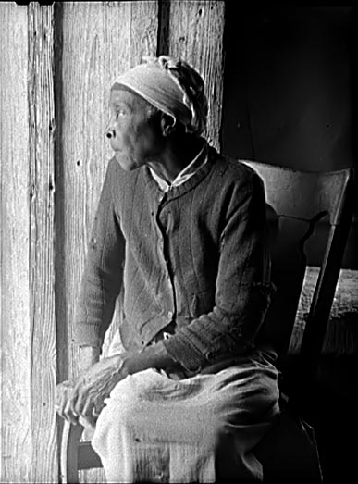
The South and Jim Crow
The southern economy develops slowly (textile mills, tobacco processing plants . . .)
Still primarily focused on agriculture, the labor source moves from slavery to tenant farming and sharecropping:
-system keeps poor farmers in debt . .
-Plessy v. Ferguson decision (1896) makes segregation legal, reverses most of the gains made after Civil War.
-Booker T. Washington v. WEB DuBois

Slide 8
Railroads and Development of the West
Importance of the railroad industry
--The post- Civil War industrial boom depended heavily on the growing railroad industry for:
--growing markets for manufactured goods
--shipment of farm products, raw materials from west to factories of the east
Grants of money and land from the federal government helped private entrepreneurs build the major railroads
--1st Transcontinental Railroad completed -- 1869
--Railroad owners took advantage of often being a monopoly, especially for western farmers, and charged unfair rates . . .

Slide 9
Railroads and Development of the West
Regulation of the railroad industry won’t begin until the 1880’s:
--1886: In the Wabash case, the Supreme Court rules that individual states cannot regulate interstate commerce
--1887: The Interstate Commerce Act is passed, which sets up the Interstate Commerce Commission to attempt to regulate the railroads.
--first time that the federal government takes on regulating the national economy!

Slide 10
Railroads and Development of the West
The End of the Era of the Plains Indians:
--As settlers moved west, Native American tribes were pushed off the Great Plains.
--Often treaties were signed giving tribes land to live on (Fort Laramie – 1851, Fort Atkinson – 1853), but these treaties were often broken when white settlers found value in the land that had been given to the tribes.
--Sioux victory at Little Big Horn (1876) shocks Americans back east, causes gov’t. to put more money, soldiers into fighting the Indians.
--Battle/massacre at Wounded Knee (1890) is the final defeat for the Plains Indians, and marks the end of the era of the Plains Indians.

Slide 11
Railroads and Development of the West
The Homestead Act (1862) – This act was passed after the southern states seceded (their congressmen would have opposed it).
--encouraged settlement out west by giving out free and low-cost land to anyone who would agree to live on that land for at least 5 years.
The Dawes Act (1887) – a well-intentioned but misguided attempt to ‘Americanize’ Indians and Indian tribes:
--gave Indians land so they could transition to farming.
--forced Indians to attend English-speaking schools.
--generally disregarded the importance of cultural tradition of the Indians.

Slide 12
National Politics
The Gilded Age
Relatively weak presidents pushed around by business leaders
(Carnegie, Rockefeller, J.P. Morgan, etc.)
The Interstate Commerce Act (1887) – 1st regulatory law in U.S. history . . .
Women fighting for the right to vote – progress slow . . .

Slide 13
The Silver Issue and the Populist Movement
Farmers wanted to increase the money supply . . .
-Bankers, industrialists wanted to keep money supply tight – a battle throughout the Gilded Age!
The Grange (farmers) movement developed into the Populist Party:
--expanded money supply
--graduated income tax
--direct election of senators
--shorter workdays
--government regulation of the railroads!
Led by William Jennings Bryan (Cross of Gold speech, supporting increase in the $ supply), the Populist Party will inspire the Progressive Movement a decade later.

Slide 14
Foreign Policy: Tariffs
How do tariff policies change? Why do they change?
--Tariffs are taxes on imports
-When Americans were subsistence farmers, they didn’t care too much about tariffs . . .
-However, when some farmers join the market farming economy (early 1800’s), and others move to the big cities to become wage laborers (mid to late 1800’s), they find that high tariffs cause higher prices for both domestic and imported goods – they call for lower tariffs!
--The powerful industrialists of the Gilded Age liked high tariffs, because they protected American businesses from foreign competition

Slide 15
Foreign Policy: Tariffs
How do tariff policies change? Why do they change?
--Wage laborers and farmers begin to push for lower tariffs – The Populist Party (1880’s – 1890’s) includes lower tariffs and a graduated income tax (to replace tariffs) as part of its party platform. It doesn’t achieve this goal, but the Progressives (1900 – 1920) will.
--During the Gilded Age, industrialists are able to continue to sway presidential elections toward Presidents who support high protective tariffs, like William McKinley.
Teddy Roosevelt (1901-1908) will be the first president to find success lowering tariffs . . .

Slide 16
Foreign Policy: Imperialism
Why did the U.S. fight the Spanish-American War? What were the results?
What were the arguments in favor of imperialism?
What were the arguments against imperialism?

Slide 17
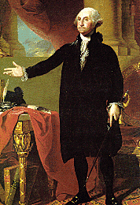
Foreign Policy: Imperialism
Until the 1890’s, the U.S. had always maintained a foreign policy of isolationism:
In 1796, George Washington had warned the country to stay out of ‘foreign entanglements’, and the U.S. had done a pretty good job of maintaining this policy . . .

Slide 18
Reasons for American Imperialism
In the 1880’s, several factors led to America changing its foreign policy to Imperialism. That is, they began acquiring territories and exerting their military and economic influence around the world:
1. Need for markets, materials
--New industrial age!
--Rubber, tin, etc. found mainly in other countries

Slide 19
Reasons for American Imperialism
Anglo-Saxon Superiority
--quote from Minister Josiah Strong in 1885:
“It seems to me that God, with infinite wisdom and skill, is training the Anglo-Saxon race for an hour sure to come in the world’s future . . . The . . . Lands of the earth are limited, and will soon be taken . . . Then will the world enter upon a new stage of its history – the final competition of races . . . Then this [Anglo-Saxon] race of unequaled energy, with all the majesty of numbers and the might of wealth behind it – the representative of the largest liberty, the purest Christianity, the highest civilization . . . Will spread itself over the Earth.”

Slide 20
Reasons for American Imperialism
3. Fear of falling behind other world powers
--The European powers had a head start –
--would the U.S. fall even further behind?
--would there be anything left to take?
4. The Necessity of Sea Power for Security
--Admiral Alfred Mahan – Sea power was needed to
1. protect shipping lanes
2. provide military security (naval bases, etc.)

Slide 21
Steps to American Sea Power:
A modern fleet
--by 1898, the U.S. had world’s 3rd largest navy
Naval bases in the Caribbean and Pacific
--Cuba – Guantanamo Bay
--Hawaii – Pearl Harbor
A canal across the isthmus of Panama
--Built by 1912!

Slide 22
Foreign Policy: Imperialism
Teddy Roosevelt (Secretary of the Navy in 1898) and Alfred Mahan were big supporters of American imperialism.
The Spanish-American War (summer of 1898) was a ‘jump-start’ for an American empire . . .
--Territories acquired in the victory over Spain:
1. The Philippines 2. Puerto Rico
3. Guam
4. Cuba?
--The U.S. gains control over Cuba (the Platt Amendment), but doesn’t own Cuba as a territory.

Slide 23
The Debate over Imperialism:
Supporters:
-Roosevelt, Mahan, and McKinley felt that it would give the U.S. more military security, access to new markets, a chance to spread American ideas (democracy, capitalism, Christianity) to the world . . .
A 3-year war in the Philippines (1898-1901) to gain control of this territory intensifies the debate over Imperialism . . .
Opponents:
-Mark Twain, Samuel Gompers (members of the Anti-Imperialist League) felt that it violated American ideals like liberty and human rights. Labor leaders feared it would lead to unemployment and lower wages . . .

Slide 24
Key Terms and Concepts:
1. The Platt Amendment
2. The annexation of the Philippines and the Philippine- American War (1898-1901)
3. The Boxer Rebellion and the Open Door Policy in China
4. The building of the Panama Canal
5. The Roosevelt Corollary
6. The Insular Cases - 1901

